Slide 1
Design patterns: The adapter and facade Pattern
Bui Vu Khoa – 1042108
Pham Tuan Kiet - 1042103

Slide 2
Table of contents
Definitions
Object vs class adapters
How it works
Use cases
Advantages and disadvantages
​Code showcase

Slide 3
Definition (adapter)
Structural pattern that involves the creation of an adapter
Acts as a bridge between two interfaces
Translate and connect

Slide 4
Definition (facade)
Structural pattern that helps provide an access interface
Important to support the loosely coupled microservices architecture

Slide 5
Object vs class adapter
Object adapter
Class adapter
Use composition to adapt the adaptee
Can adapt multiple adaptees at once
No need to specify all parameters when instantiating the adapter
Use inheritance to adapt the adaptee
Able to override some of the adaptee's behavior since it uses inheritance
Can only adapt a single adaptee at a time

Slide 6
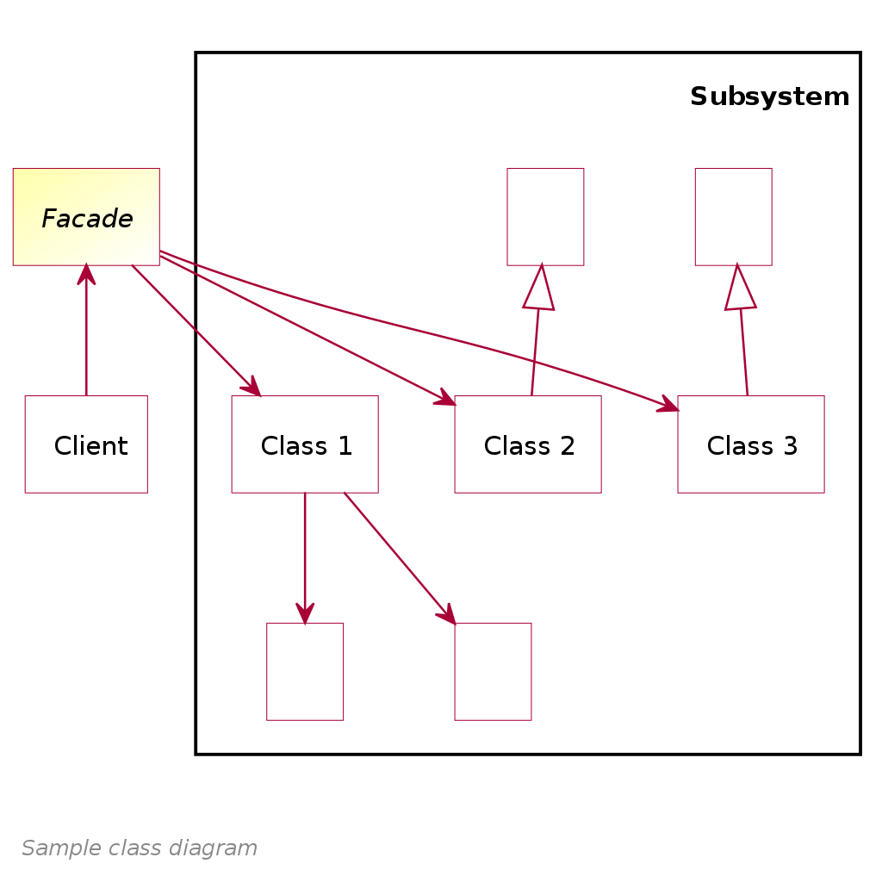
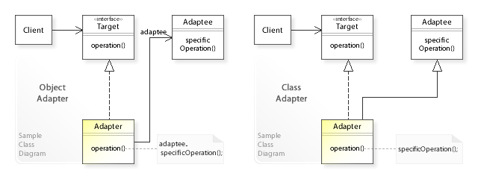
How it works

Slide 7



Use cases
deal with different interfaces with similar behavior
(Adapter)
simplify the interaction with a large number of objects (façade)
software projects with multiple layers (façade)

Slide 8


Adv/disadv (adapter)
Advantages
Disadvantages
Connect multiple different interfaces
Ease of access
Additional levels of indirections
Can lead to large amounts of separate adapters

Slide 9
Adv/disadv (facade)
Advantages
Disadvantages
Simplified interface view for users
Decouple code from subsystems
Make it difficult for developers
Can lead to one object that’s too large

Slide 10

Code showcase

